Slide 1
AppLink BaaS平台
让移动开发更简单
致力于构建互联网创业生态圈 帮助创业者成功
Notes:
NNG award
+ MRC Certification on first slide

Slide 2
目录
什么是BaaS
AppLink
SWOT
市场分析
竞争性分析
现状
展望未来
联系方式
Notes:
Eyeblaster Analytics is not a product – it is what marketers call a Component Brand ‘- i.e. it is a self-branded subset of a product

Slide 3

BaaS Introduce
云计算的衍生
技术分工的产物
天下武功为快不破

Slide 4






BaaS 的餐厅比喻
餐厅老板
=甲方
场地
=IssS（设施及服务）
餐厅
=PaaS（平台及服务）
决定餐厅菜色，服务，风格
决定应用功能，业务，类型
房地产商、商场
机房中心或阿里云
租赁场地
操作系统、虚拟服务器
餐厅前场
=SaaS（软件及服务）
=APP或网站
工作团队
=服务团队
厨房
=数据服务
选择菜品，服务的地方
应用提供服务，功能的界面
下单给厨房，端菜上桌子
数据管理，客户服务
订单变成菜品
用户数据加工
Notes:
Complimentary tools for different use cases
Campaign Monitor
One-click reporting (POWERPOINT GENERATOR)
Report Generator (ONLINE REPORTING)
Custom Report Builder- custom reports or service
Advanced Analytics (Plug-in for Excel)

Slide 5
BaaS 的餐厅比喻
装修
=应用开发
装修餐厅前场和后厨
开发APP的前端和后端
装修过程
=开发过程
木工、水工、电工、漆工干活
开发，设计，架构研发
厨房器件供应商
=BaaS（后端及服务）
水槽、炉灶、冰箱
数据处理服务
Notes:
Complimentary tools for different use cases
Campaign Monitor
One-click reporting (POWERPOINT GENERATOR)
Report Generator (ONLINE REPORTING)
Custom Report Builder- custom reports or service
Advanced Analytics (Plug-in for Excel)

Slide 6



BaaS(后端即服务)
应用后端技术整合
数据存储
统计
无服务器
移动技术集成（直播，通知，存储等）
优点
效率加快60%
成本降低60%
技术门槛减少
敏捷迭代
目标群体
互联网企业
创业团队
个人开发工程师
Notes:
Before the first thumbnail is scribbled on a napkin, you must define the goals of your campaign: What do you want to achieve, how much of it do you want to achieve, and what measurement best communicates the two? Once your goal is defined in terms of collectable data, ask how the creative execution drives towards that goal. And, when the campaign is finished, an in-depth data analysis is crucial to leverage your past experience to better optimise future campaigns. Increase your success metrics by basing your creative plan on sound analytical strategy.

Slide 7

BaaS的用户痛点——流于mBaaS
只支持APP开发
收费贵
捆绑式销售
支持少
等等等等
Notes:
Digital Advertising provides Agencies with something traditional channels have never been able to deliver—The ability to track and measure consumers interactions and engagement with your Brand Message.
However, as Digital advertising has evolved, with multi-channel campaigns, being tracked by disparate reporting systems, the amount and variety of metrics have increased to the point where Agencies are now drowning in a sea of information.
How do you stay afloat in, let alone take advantage of, the overwhelming amount of data that digital campaigns create?
Eyeblaster Analytics

Slide 8
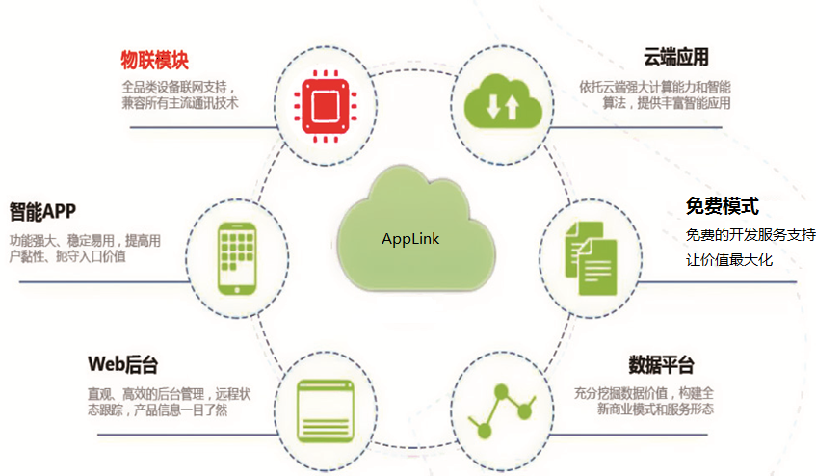
AppLink是一站式的完整互联网解决方案

Slide 9
五大市场
云开发平台
自动化构建数据管理系统
移动互联网敏捷开发框架
BaaS（Backend-as-a-Service，后端即服务）
知识共享的应用商店

Slide 10

Strength优势
自主研发
著作权、专利、Apache基金会
技术优势
提高效率、减少成本、降低门槛
竞争优势
专注早期、知识付费、免费
创始人
十年草根、优秀企业、技术广、行业广
Notes:
Digital Advertising provides Agencies with something traditional channels have never been able to deliver—The ability to track and measure consumers interactions and engagement with your Brand Message.
However, as Digital advertising has evolved, with multi-channel campaigns, being tracked by disparate reporting systems, the amount and variety of metrics have increased to the point where Agencies are now drowning in a sea of information.
How do you stay afloat in, let alone take advantage of, the overwhelming amount of data that digital campaigns create?
Eyeblaster Analytics

Slide 11

Weakness劣势 && Threat威胁
市场能力
缺少完成团队
缺少证明
经营企业经验
被抄袭的威胁
Notes:
Digital Advertising provides Agencies with something traditional channels have never been able to deliver—The ability to track and measure consumers interactions and engagement with your Brand Message.
However, as Digital advertising has evolved, with multi-channel campaigns, being tracked by disparate reporting systems, the amount and variety of metrics have increased to the point where Agencies are now drowning in a sea of information.
How do you stay afloat in, let alone take advantage of, the overwhelming amount of data that digital campaigns create?
Eyeblaster Analytics

Slide 12

Opportunity机会
政策与市场
互联网+下的中国互联网市场
技术趋势
软件开发的必然
需求在改变
企业IT服务化改革、创业者浪潮
BaaS市场不成熟
技术、方向的痛点
Notes:
Digital Advertising provides Agencies with something traditional channels have never been able to deliver—The ability to track and measure consumers interactions and engagement with your Brand Message.
However, as Digital advertising has evolved, with multi-channel campaigns, being tracked by disparate reporting systems, the amount and variety of metrics have increased to the point where Agencies are now drowning in a sea of information.
How do you stay afloat in, let alone take advantage of, the overwhelming amount of data that digital campaigns create?
Eyeblaster Analytics

Slide 13
77亿美元背后的市场
据Marketsandmarkets发布的报告，到2017年全球BaaS行业的市场规模也仅为77亿美元。
技术没有捷径
为创业者而生
大趋势下的低风险
数据量大
数据跨度大
企业服务市场
Notes:
Site Overlap. Accurately measure unique users contributed by each publisher. Identify when publishers overlap to deliver multiple impressions to the same user. Site Overlap provides clarity about the effect of each element of your media plan.

Slide 14


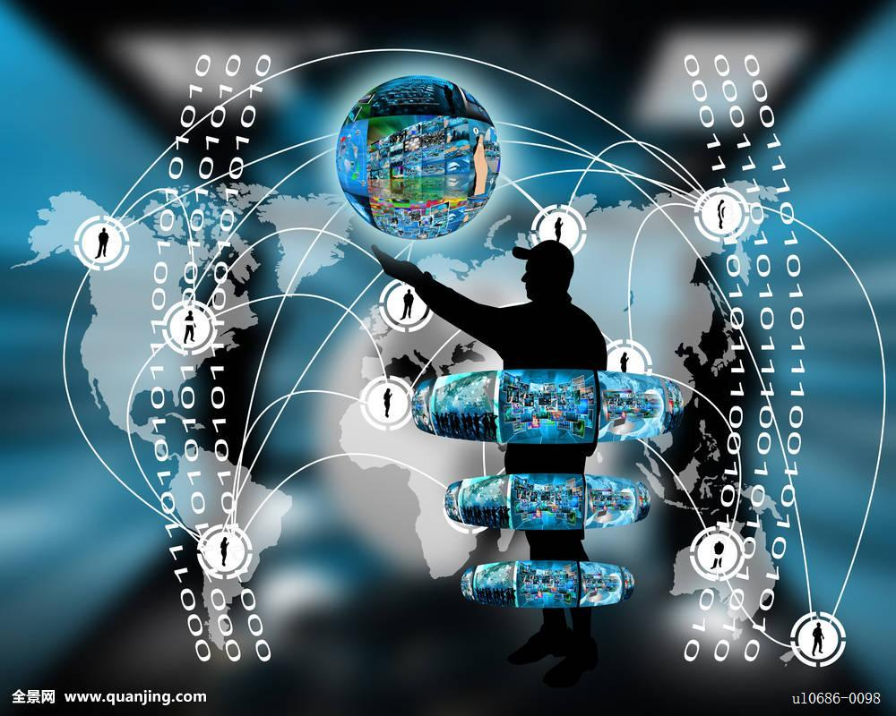
市场分析
技术趋势
技术发展的必然
移动互联网的需要
移动垂直领域的延伸
市场趋势
企业的IT服务潮流
环境趋势
创业创新的浪潮
Notes:
Before the first thumbnail is scribbled on a napkin, you must define the goals of your campaign: What do you want to achieve, how much of it do you want to achieve, and what measurement best communicates the two? Once your goal is defined in terms of collectable data, ask how the creative execution drives towards that goal. And, when the campaign is finished, an in-depth data analysis is crucial to leverage your past experience to better optimise future campaigns. Increase your success metrics by basing your creative plan on sound analytical strategy.

Slide 15
市场趋势——企业的IT服务改革
企业内部信息化之后的对外客户IT服务
实业企业成立软件开发部门是不可能的，对外包是潮流
行业的创新会在移动互联网的基础上出现，颠覆传统行业
实体服务
互联网思想
颠覆传统
Notes:
Site Overlap. Accurately measure unique users contributed by each publisher. Identify when publishers overlap to deliver multiple impressions to the same user. Site Overlap provides clarity about the effect of each element of your media plan.

Slide 16
家装企业IT服务 改革进行时
龙头企业的APP，小公司不想复制吗？ 提供AR/VR的方式跟踪装修进度？
材料供应商商城 完整的售后服务跟踪
实业+IT服务=未来
Notes:
If I usually do something, and as a result I spent twice as long than the average on the page, it’s telling me something - Brand moment is being built.
If they are doing something as a result, it is telling me something. That that brand impact has not caused me to invest more of my time.
So how do we measure time? How do we give it a value? “Dwell Time” is the latest answer from Eyeblaster to try an answer online where TV currently fails – whether the user was in front of the TV or not. It is a solution to justifying the audience is actually taking in the message.
Not just what they did but for “how long” – it is “brand time” – a point of measurement that can show the impact on the audience where they are.
It goes much deeper then reach and frequency. It goes deeper than page open – all they do is show me exposure, not that I have a connected relationship.
The metrics advertisers should look at, for brand campaign, is reach (how many were consumers were affected) frequency (how many times) and dwell time (how long).

Slide 17



目标市场
应用开发工程师
数据后端服务
知识共享、消费
爱创业接订单平台
企业级IT服务外包
快速支持企业级的IT服务，为企业提供互联网服务的定制化服务
爱创业平台外包服务
互联网创业项目
协助创业者完成早期项目，组成团队
爱创业平台外包服务
Notes:
Before the first thumbnail is scribbled on a napkin, you must define the goals of your campaign: What do you want to achieve, how much of it do you want to achieve, and what measurement best communicates the two? Once your goal is defined in terms of collectable data, ask how the creative execution drives towards that goal. And, when the campaign is finished, an in-depth data analysis is crucial to leverage your past experience to better optimise future campaigns. Increase your success metrics by basing your creative plan on sound analytical strategy.

Slide 18








竞争对手
Back to Metrics slide
企业级的QingCloud的APPCenter、阿里云移动和AWS的Mobile Hub
致力于构建开发者生态圈的野狗、LeanCloud和Bmob后端云
整合前后端的APPCAN和APICloud
Notes:
Site Overlap. Accurately measure unique users contributed by each publisher. Identify when publishers overlap to deliver multiple impressions to the same user. Site Overlap provides clarity about the effect of each element of your media plan.

Slide 19



致力于构建开发者生态圈的野狗、LeanCloud和Bmob后端云
提供各种移动技术服务，但是因为技术和规模的问题，用户并不想用
使用的技术相同
先后完成千万美元级别的A轮
LeanCloud吸收腾讯TAB成为用户最多
野狗的广告投入较高
Bmob利用支付接入立足
主要竞争对手

Slide 20
竞争策略
企业外包服务
爱创业平台
AppLink
研发中心
强大的基础核心，
才能支撑业务的开展
开发生态圈
主动向市场的业务突破
自我造血功能
打开AppLink的知名度
让AppLink不断进化
企业IT服务外包
创业项目外包
社区化、持续化的创业平台，一个idea变成一个项目
帮助创业者成功

Slide 21

项目现况
时间表
团队配置
投资需要
Notes:
Its a busy world and so much is fighting for our attention...
Times have changed. We are in the instant digital world. Its fast-paced learning. Time is now even more precious.
Now in this fragmented world it is about grabbing a few moments of my time.
We have to learn to build brand moments
We need a new way to measure those brand moments, we need to measure time!!
Reveals difference between interest and intent

Slide 22
时间表
2016年12月AppLink项目正式启动。
2017年1月中旬，AppLink项目1.0版本正式完成，约三万行代码。
2017年3月中旬，AppLink项目完成其他部分，正式推向市场。
2017年6月，基于AppLink的核心技术的研发技术，完成爱创业平台。
2017年8月为止，AppLink项目已经先后完成创桥教育科技的“成功父母必听”，“大脑检测系统”，“空中幼儿园”三个项和其它“BB作手” 、“宠物流浪日记”等项目。
2017年9月，创桥教育科技已完成600万元人民币的天使阶段融资，并与AppLink平台签署战略合作伙伴关系协议。
© 2008 Eyeblaster. All rights reserved

Slide 23
人员配置
创始人——蔡笋
深圳大学软件工程硕士
PMP
全栈工程师
Dev-Ops
ipiao.com首席开发
金蝶k3Cloud供应链系统架构师Morningstar的AWS部门Dev-Ops和架构师
十年移动互联网外包经营
联合创始人—胡春生
市场战略顾问
深运工贸企业有限公司市场部及人事部经理
协助深运集团进军餐饮业的市场
联合创始人—张少龙
市场及投资顾问
澳洲麦考瑞大学本科、硕士海归
华为巴基斯坦项目的安全事务官
澳洲智维投资集团开展商业中心的投资事务
Notes:
Before the first thumbnail is scribbled on a napkin, you must define the goals of your campaign: What do you want to achieve, how much of it do you want to achieve, and what measurement best communicates the two? Once your goal is defined in terms of collectable data, ask how the creative execution drives towards that goal. And, when the campaign is finished, an in-depth data analysis is crucial to leverage your past experience to better optimise future campaigns. Increase your success metrics by basing your creative plan on sound analytical strategy.

Slide 24
种子期的需求——10%换取100万人民币
组建5人平台研发团队
组建5人市场开发团队
组建5人项目外包团队
租赁办公场所及用品等
租赁服务器等
申请各种证明、创新等费用

Slide 25


Thank you
蔡笋
联系我
联系电话：13751082562
微信/QQ： 359304951
邮箱：alucard263096@126.com
访问APP后端云

